Slide 1
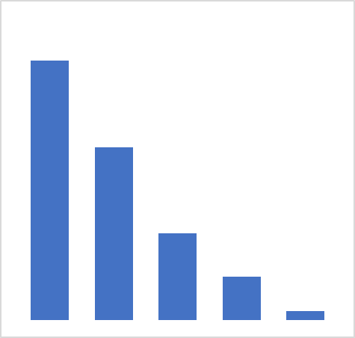

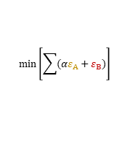
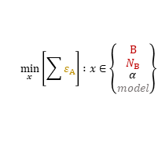
PETN
TNT
Α
NTO
RDX
$$\min\left[\sum{(αε_{Α}+ε_{Β})}\right]$$
CL-20
LLM-105
DNAN
HMX
Β
similarity
$$\min_{x}\left[\sum{ε_{Α}}\right] :x∈\left\{\begin{matrix}\begin{aligned}Β \\ N_{Β}\end{aligned} \\ α \\ model\end{matrix}\right\}$$
{CHNOF}
172 million
{CHNOF}
$$N_{Β}$$

Slide 2
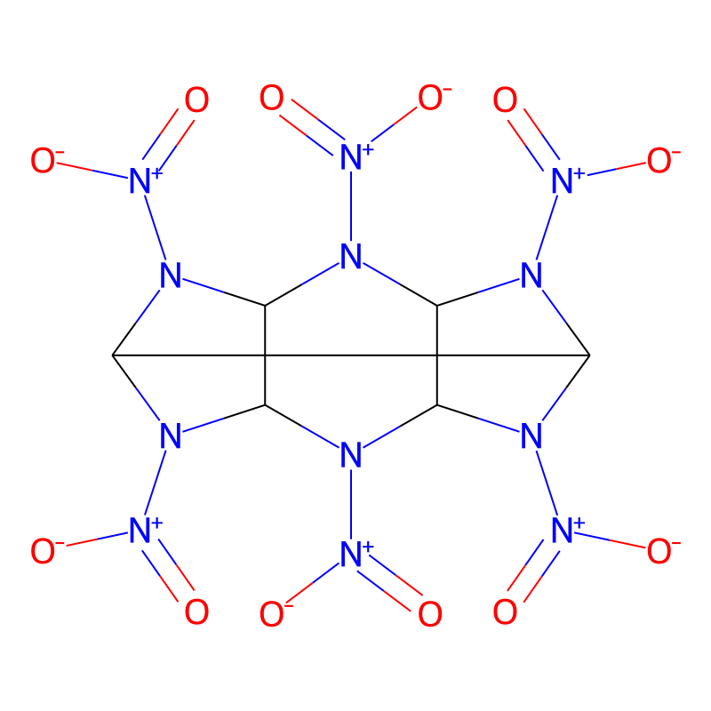


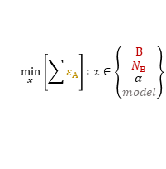
{Energetics}
$${N_{A}≪N}_{Β}$$
Α
$$\min\left[\sum{(αε_{Α}+ε_{Β})}\right]$$
Β
similarity
$$\min_{x}\left[\sum{ε_{Α}}\right] :x∈\left\{\begin{matrix}\begin{aligned}Β \\ N_{Β}\end{aligned} \\ α \\ model\end{matrix}\right\}$$
{CHNOF}
172 million
{CHNOF}
$$N_{Β}$$

